Slide 1
Understanding and Developing Large Language Models (LLMs)

Slide 2
AGENDA
Introduction to AI: From Theory to Practice
The Dream of AGI: Aspirations and Discussions
LLMs: The First Step Towards AGI
Enhancing LLM Performance: Techniques and Metrics
Production and Ethical Considerations of AI Models

Slide 3
Introduction to AI: From Theory to Practice

Slide 4
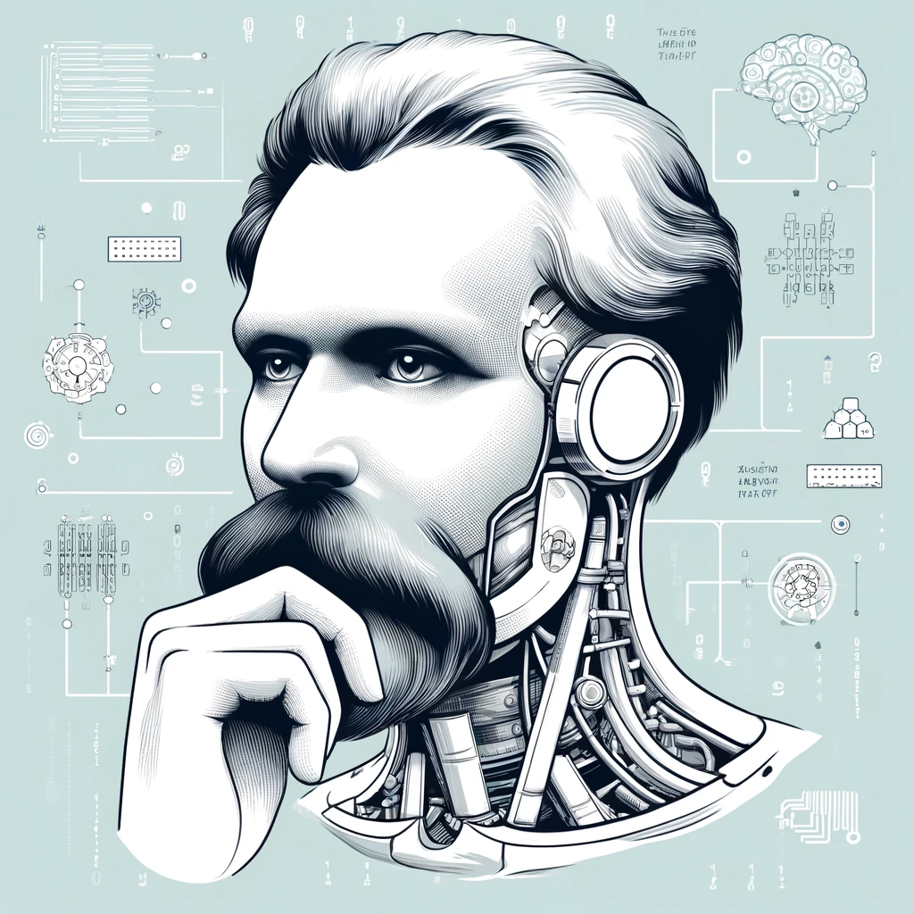
What is AI?

Slide 5





What is AI?
AI models
Computer vision
Natural Language Processing
Sound processing

Slide 6


What is AI?
Predictions
AI models
Data

Slide 7

The Dream of AGI: Aspirations and Discussions

Slide 8
Artificial General Intelligence (AGI)
means Artificial Intelligence that matches (or outmatches) humans on a range of tasks.

Slide 9
Artificial General Intelligence (AGI)
A decade ago: We believed AI would master the exact sciences, leaving art and human creativity untouched.
Today:
The opposite is true—AI is transforming creativity, reshaping our understanding of art and innovation, having troubles with exact sciences.

Slide 10
LLMs: The First Step Towards AGI

Slide 11
Large Language Models (LLMs)
AI models capable to understand and generate human language with remarkable accuracy.

Slide 12
Large Language Models (LLMs)
How to translate human language in machine language?
How to understand the complexity of the human language?

Slide 13
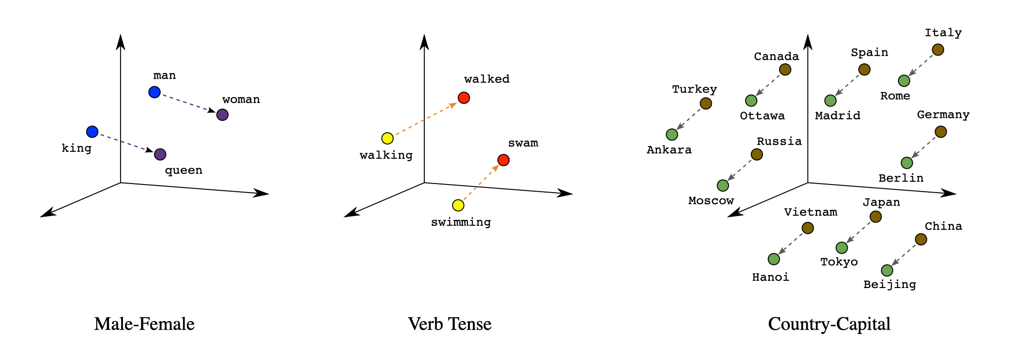
Large Language Models (LLMs)
How to translate human language in machine language?

Slide 14
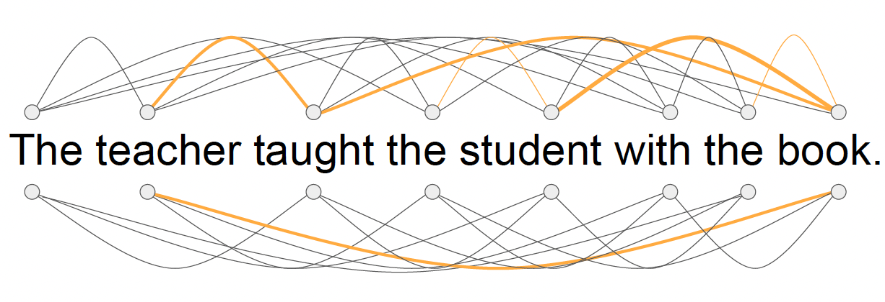
Large Language Models (LLMs)
How to understand the complexity of the human language?
[1]

Slide 15
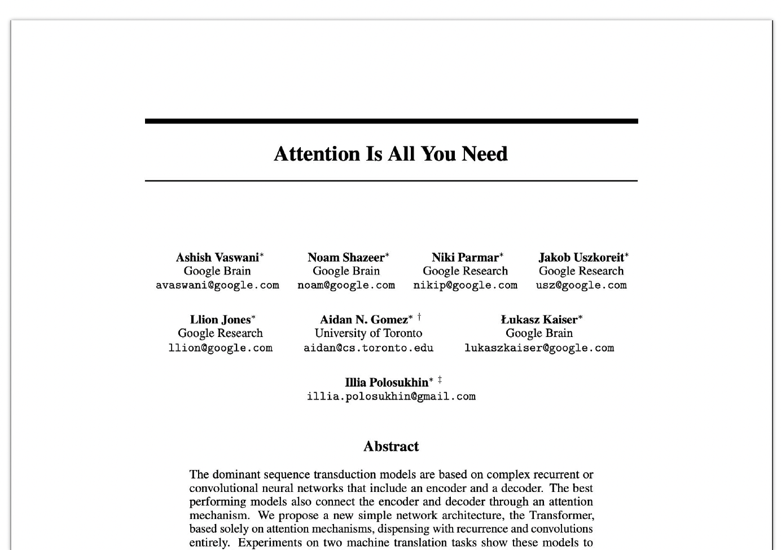
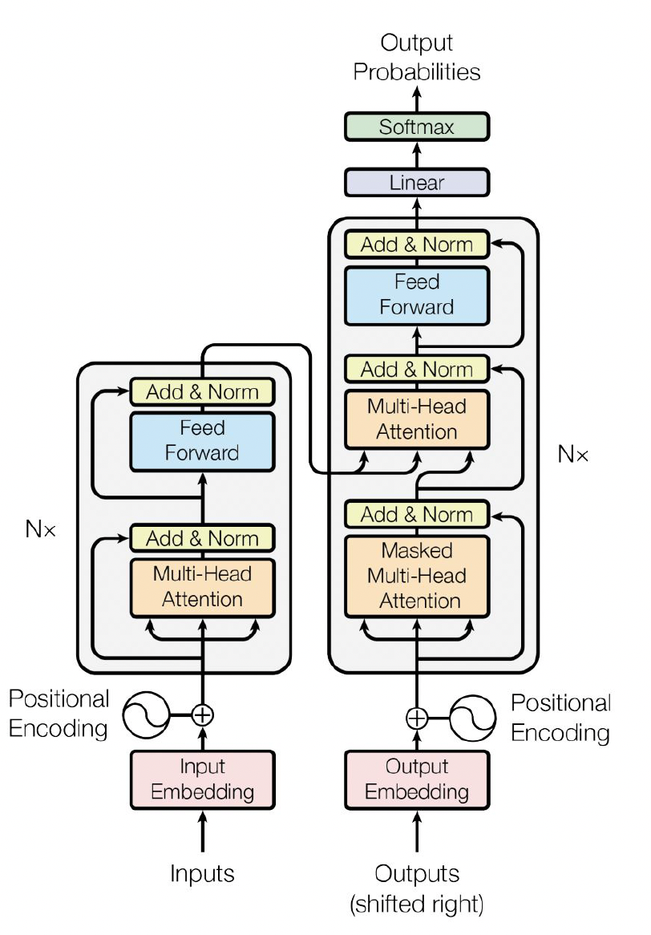
Large Language Models (LLMs)
Transformers

Slide 16
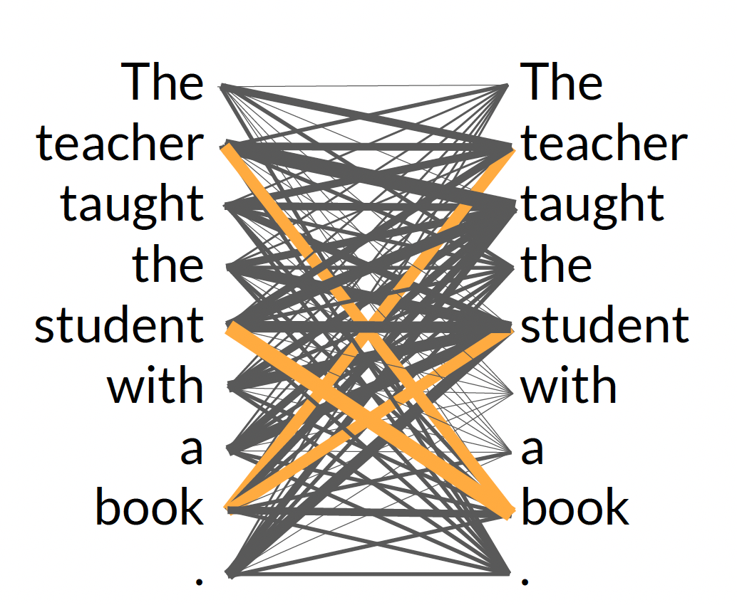

Large Language Models (LLMs)
[1]
Transformers

Slide 17


Large Language Models (LLMs)
LLM
prompts
completions
What is the capital of Romania?
The capital of Romania is Bucharest.

Slide 18
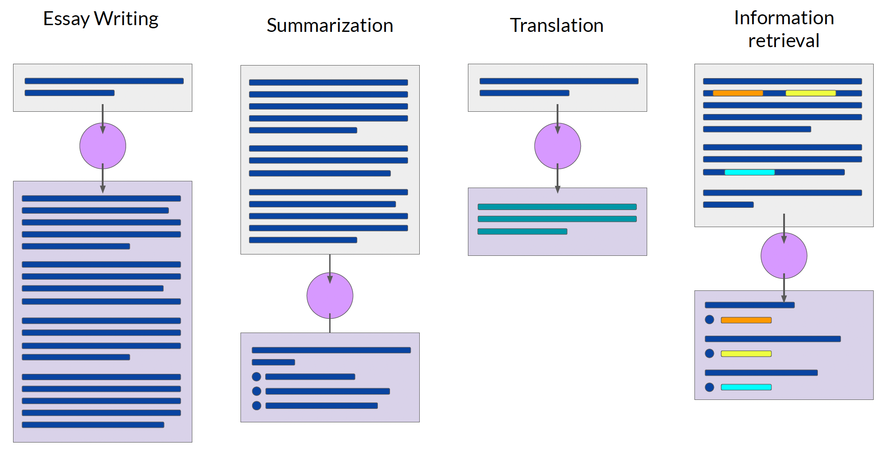
Large Language Models (LLMs)
[1]

Slide 19
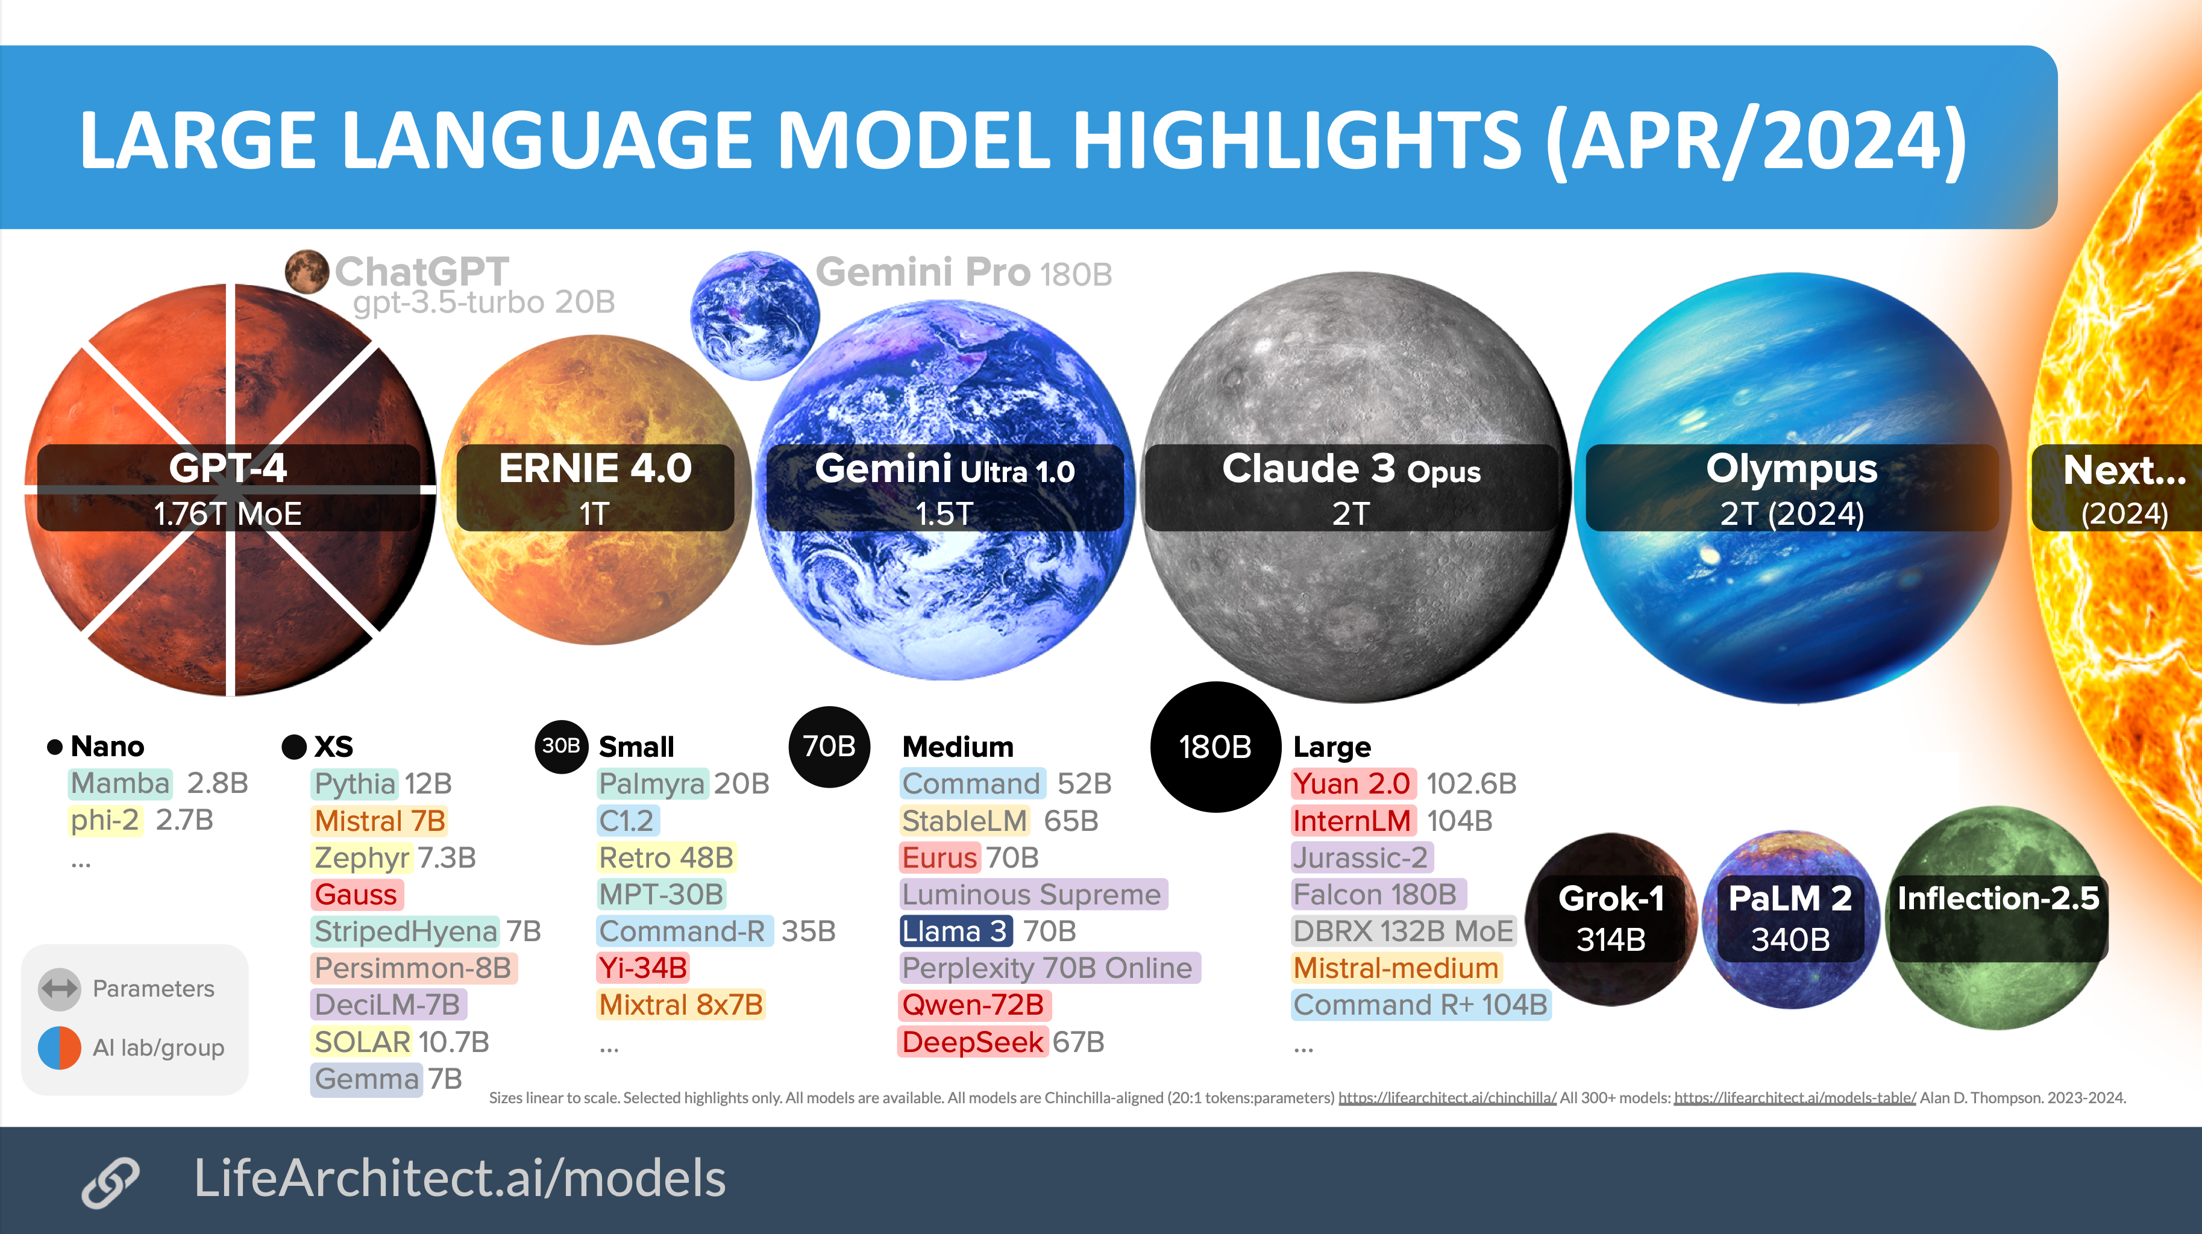
Large Language Models (LLMs)

Slide 20
Enhancing LLM Performance: Techniques and Metrics

Slide 21
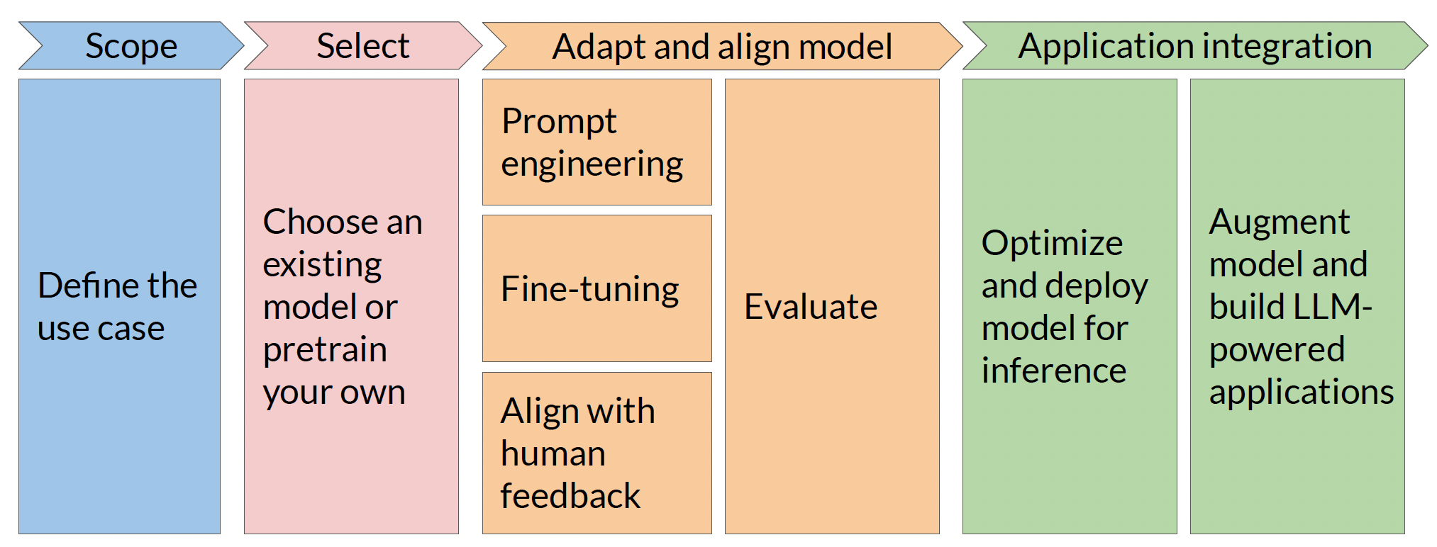
LLM Lifecyle
[1]

Slide 22
LLM Lifecyle
[1]
[1]

Slide 23

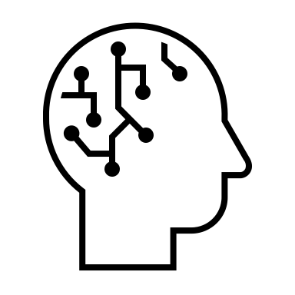

LLM Lifecyle
[1]
?
Pretrained LLM
Custom LLM

Slide 24
LLM Lifecyle
[1]
Classify the text into positive, neutral or negative.
Text: That shot selection was awesome.
Classification:
Classify the text into positive, neutral or negative.
Text: Today the weather is fantastic
Classification: Positive
Text: The furniture is small.
Classification: Negative
Text: I don't like your attitude
Classification: Negative
Text: That shot selection was awful
Classification:
Context
window
Zero shot
Few shot

Slide 25
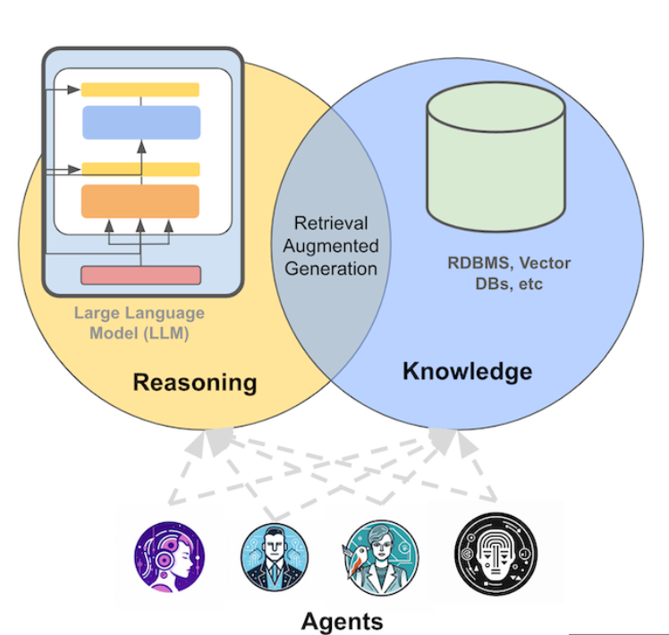
LLM Lifecyle
[1]

Slide 26
RESPONSIBLE AI
[1]
Toxicity
Hallucinations
Intellectual property

Slide 27
RESPONSIBLE AI - Toxicity
Generation of harmful, offensive, or inappropriate content. This encompasses hate speech, biased statements, and any language that targets individuals or groups based on sensitive characteristics like race, gender, religion, or sexual orientation.
[1]
Mitigation:
careful curation of training data
use Constitutional AI
Diverse group of human annotators

Slide 28
RESPONSIBLE AI - Hallucinations
[1]
Generation of factually incorrect content.
Mitigation:
educate users about how to generative AI works
disclaimers
verified databases
Define intended/unintended use cases (few shot)

Slide 29
RESPONSIBLE AI - Intellectual property
[1]
Generate content that is not under copyright issues.
Mitigation:
- better policy/legal mechanisms
machine “unlearning”

Slide 30
THANK YOU
bogdan.mursa@ubbcluj.ro

